Slide 1
Period Product Initiative
By Student Government Association

Slide 2
THE SGA's JOURNEY

Slide 3
Last Year To Now
The initiative goes back to the Fall of 2022
It was started by a small club called Progressive Minds
There wasn’t enough tangible support at the time
By the end of the semester the initiative had ended
Put us in a good position to revamp the initiative
Notes:
Eliminated some of the initial barriers to entry
We started with a $500 grant for the purchase of menstrual product
Provided us a model for how to start the initiative

Slide 4
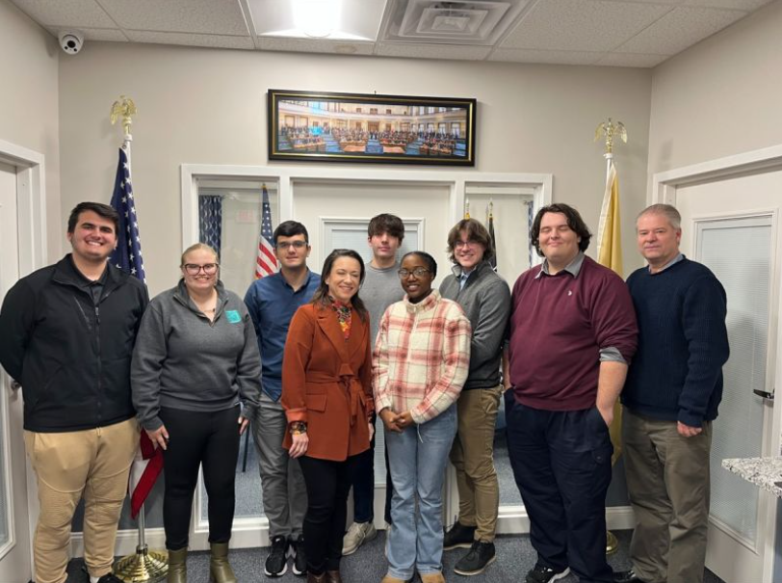
State Policy
On 06/30/23 the NJ State Assembly and Senate voted to pass the bill (S-1221/A-1349) which “Establishes program in DOE to reimburse school districts for providing menstrual products in certain public schools and requires State to pay costs”
2021 study commissioned Thinx and PERIOD provided eye-opening data
We met with Assemblywoman Dunn about our initiative and this recent policy

Slide 5
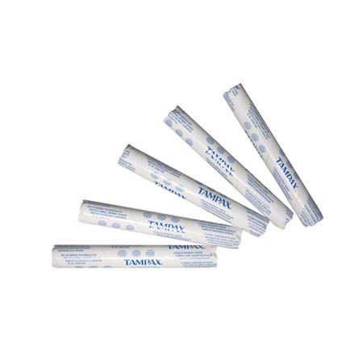
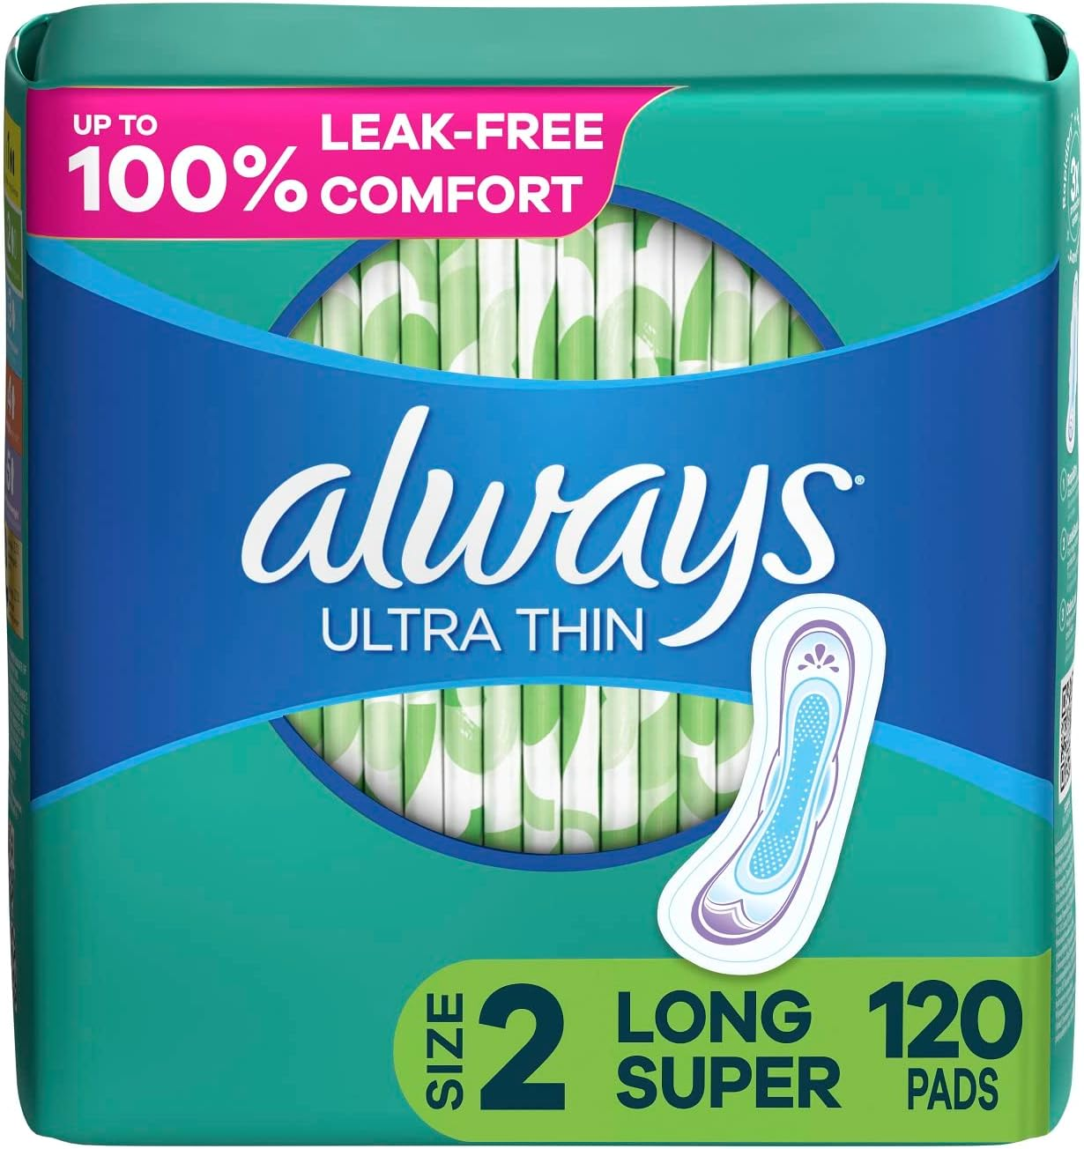
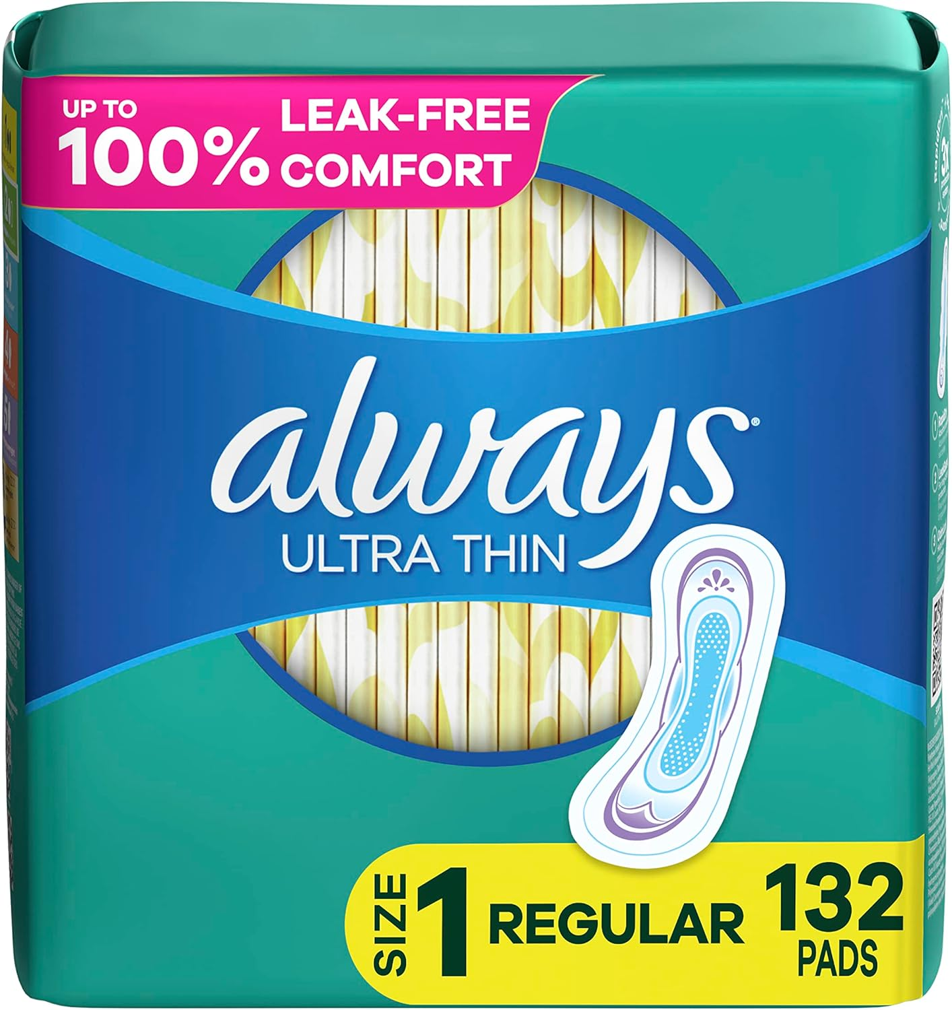


September-October: Developing Support & Direction
Confirmed a purchase option
Developed a marketing plan
Had everything prepared and rolled out on October 30th
Had over 50 individuals providing some form of instrumental support
We had people completing tasks like stocking, inventory counts, marketing, event planning, fundraising, research and data collection

Slide 6



October: Fundraising
The United Latino Organizations hosted an empanada and bracelet sale
The Feminist Empowerment Organization organized a TIE-DYE Fundraiser
The SGA put together an ON-THE-GO Bakesale

Slide 7


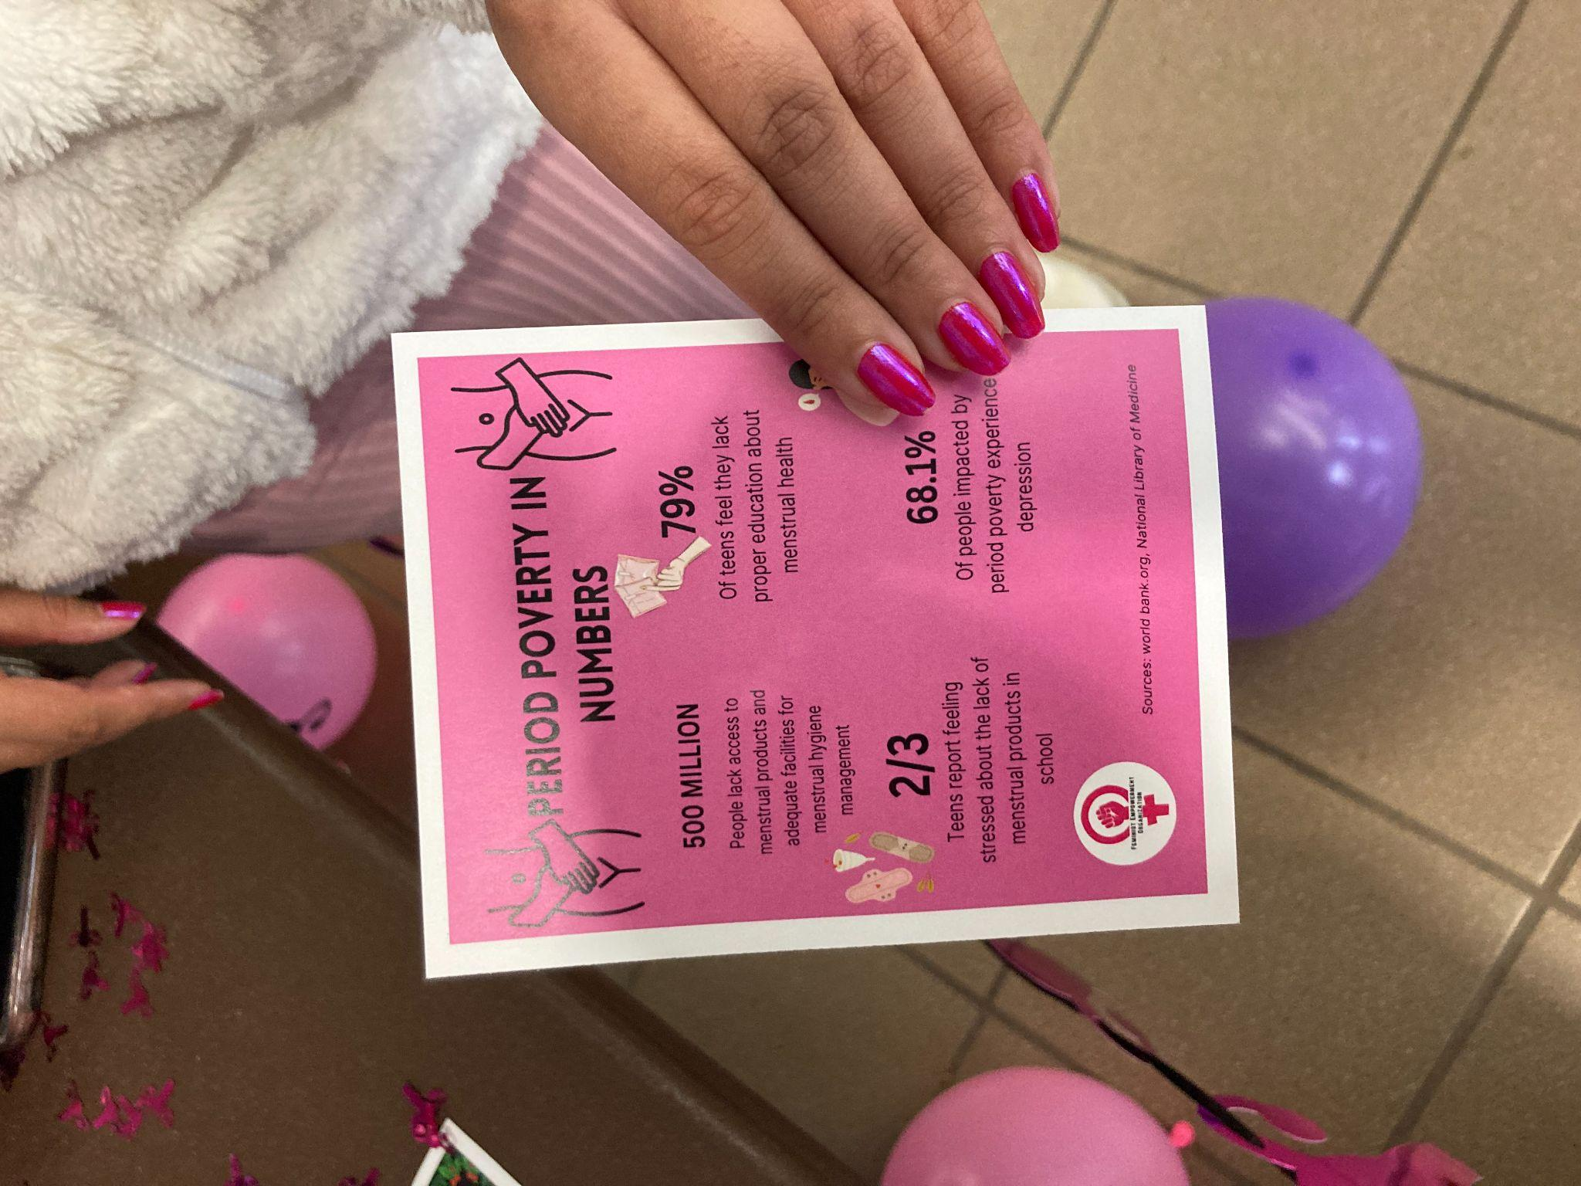
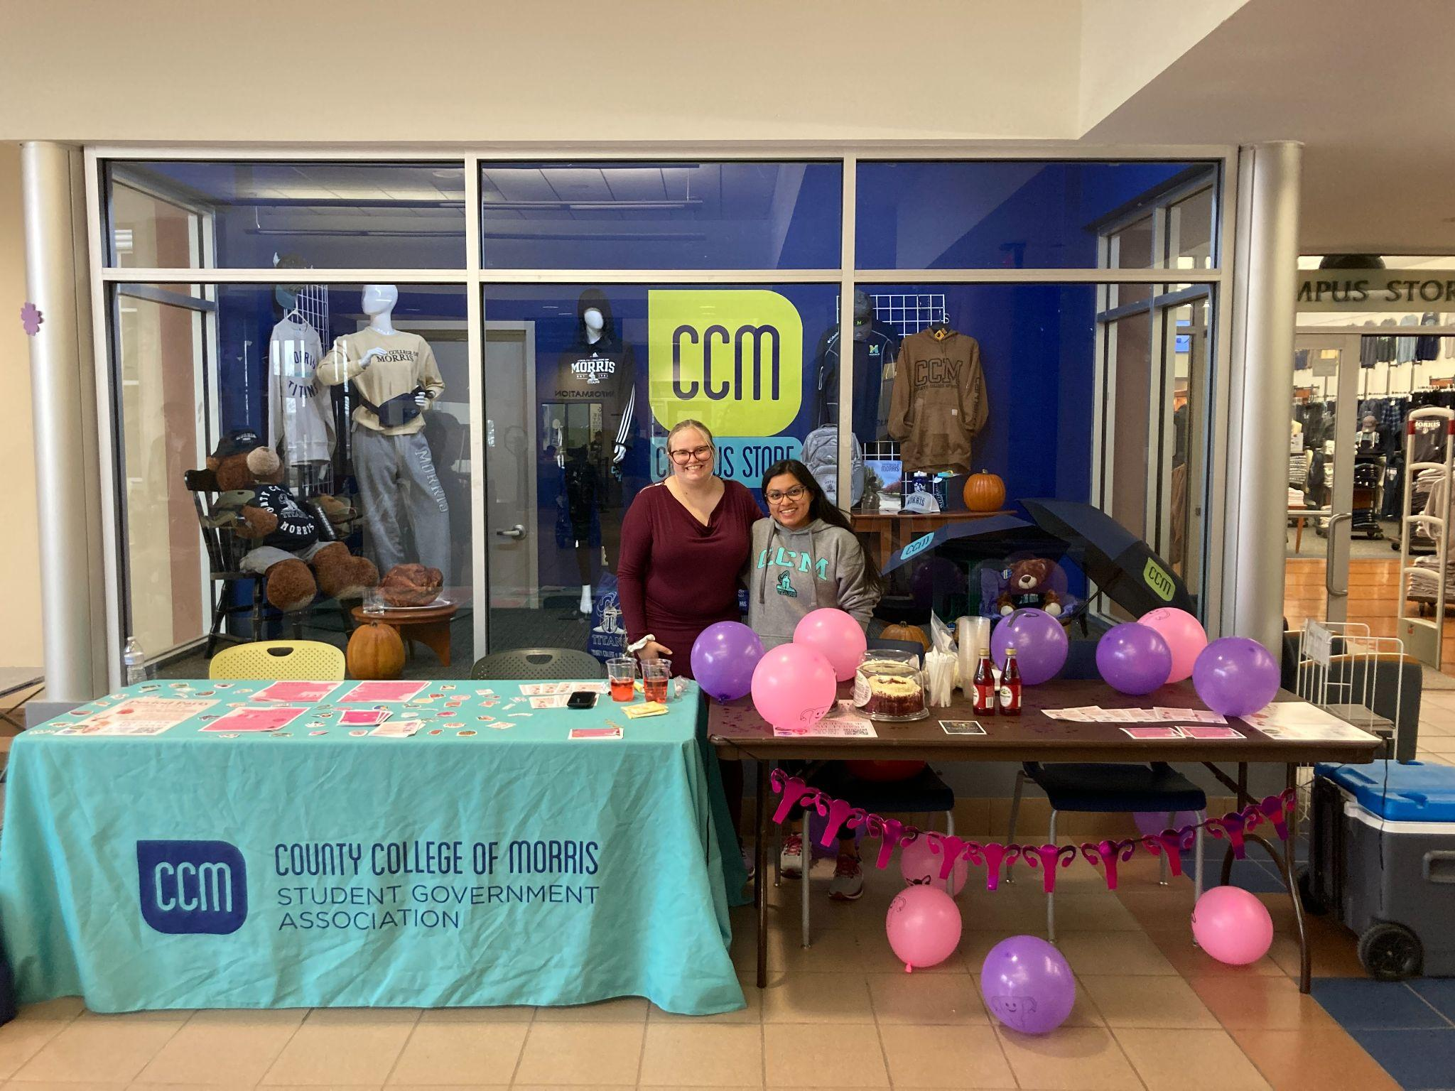
November-December: Data Collection & Destigmatization
Period Party Goals:
Destigmatize the topic of menstruation
Educate people on menstruation and Period Poverty
Raise awareness around the initiative
Ensure students were aware of the free menstrual products on campus

Slide 8
Free Products Usage Frequency and Cost
Inventory was taking over 6 weeks (10/30-12/8)
Products were restocked weekly on Friday or Monday
Measure | Tampons | Pads S-1 | Pads S-2
Starting Total | 2500 | 1320 | 504
Total Used | 565 | 500 | 232
% of Total Used | 43.56% | 38.55% | 17.89%
Weekly Average | 113 | 100 | 46.4
Estimated Annual | 9605 | 4250 | 1972
Cost | Tampons | Pads S-1 | Pads S-2
Per unit | $ 0.11 | $ 0.13 | $ 0.16
Total | $ 59.61 | $ 63.85 | $ 36.73
% of Total | 37% | 40% | 23%
Weekly Average | $ 11.92 | $ 12.77 | $ 7.35
Estimated Annual | $ 506.69 | $ 542.73 | $ 312.21

Slide 9
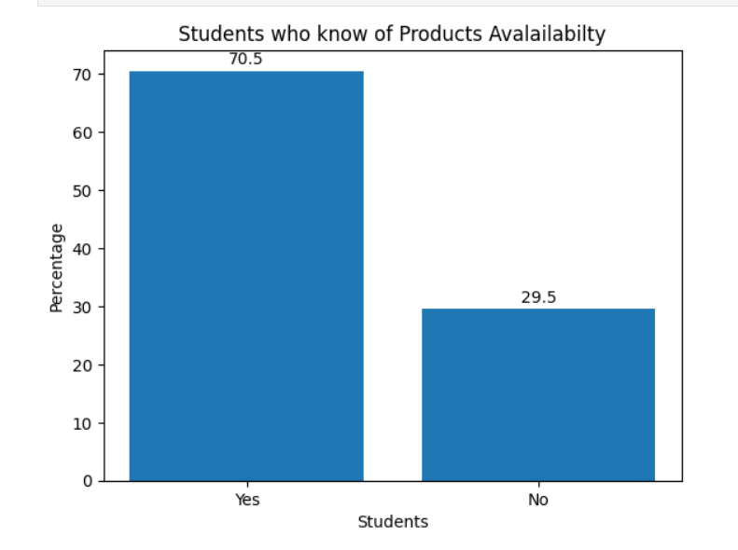
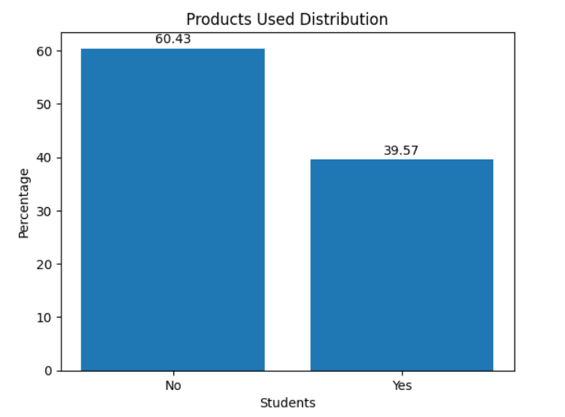
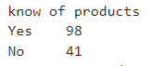
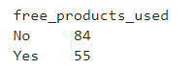
Outreach

Slide 10
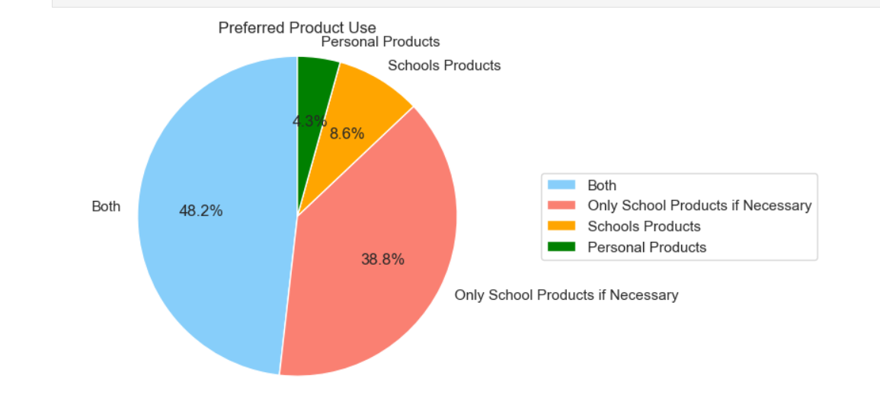
Distribution of Products Usage Sources

Slide 11
Student Survey

Slide 12
Methodology (Data Collection)
Began on (11/13/23)
Collected 213 student surveys
Survey duration 30 secs to 2 mins
3 Avenues for Data Collection
Mass Email and QR code
Promotion during Events
In-Person data collection
Ended on (12/8/23)

Slide 13
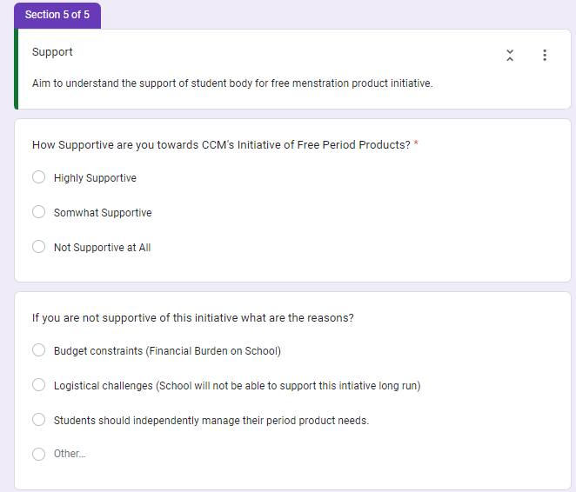
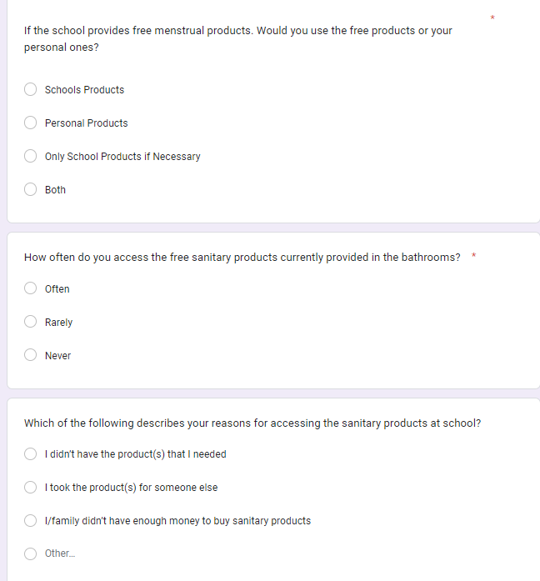
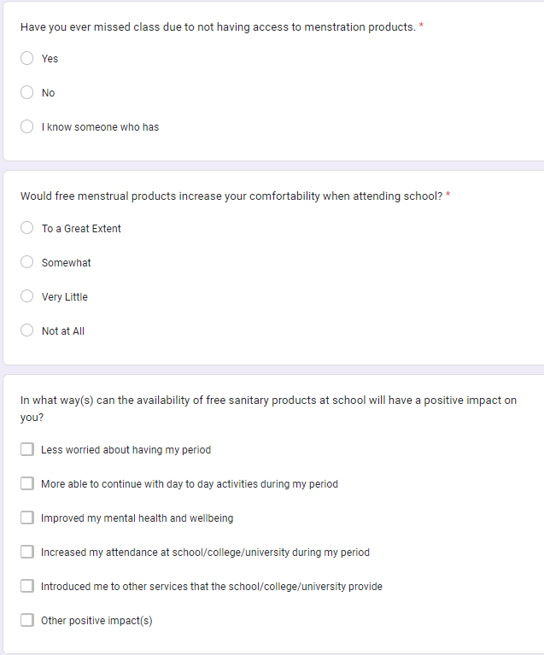
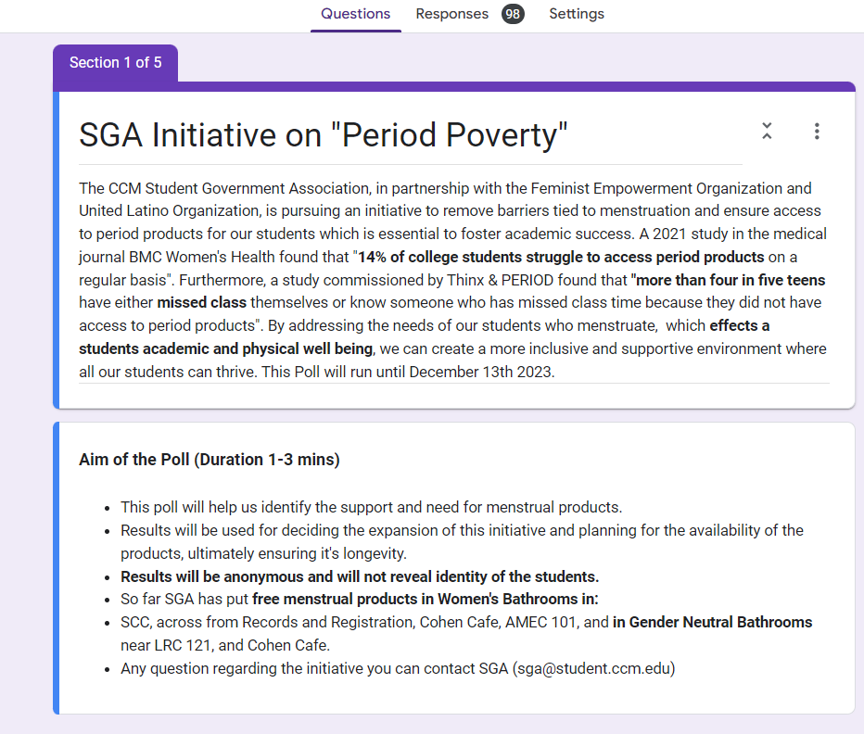
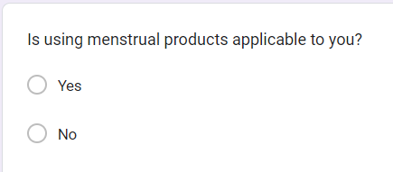
Survey Question
Demographic Questions
Menstruation Product Usage
Menstruation Product Impact
Menstruation Product Support

Slide 14
Methodology (Class)
Dataset was stored in CSV
Jupyter Notebook
Matplotlib
Pandas to create new Dataframes
Seaborn
Data Type: objects
Most Used functions value_counts(), and replace()
Outside sources used geeksforgeeks.org and AI tool when reached exhaustion

Slide 15
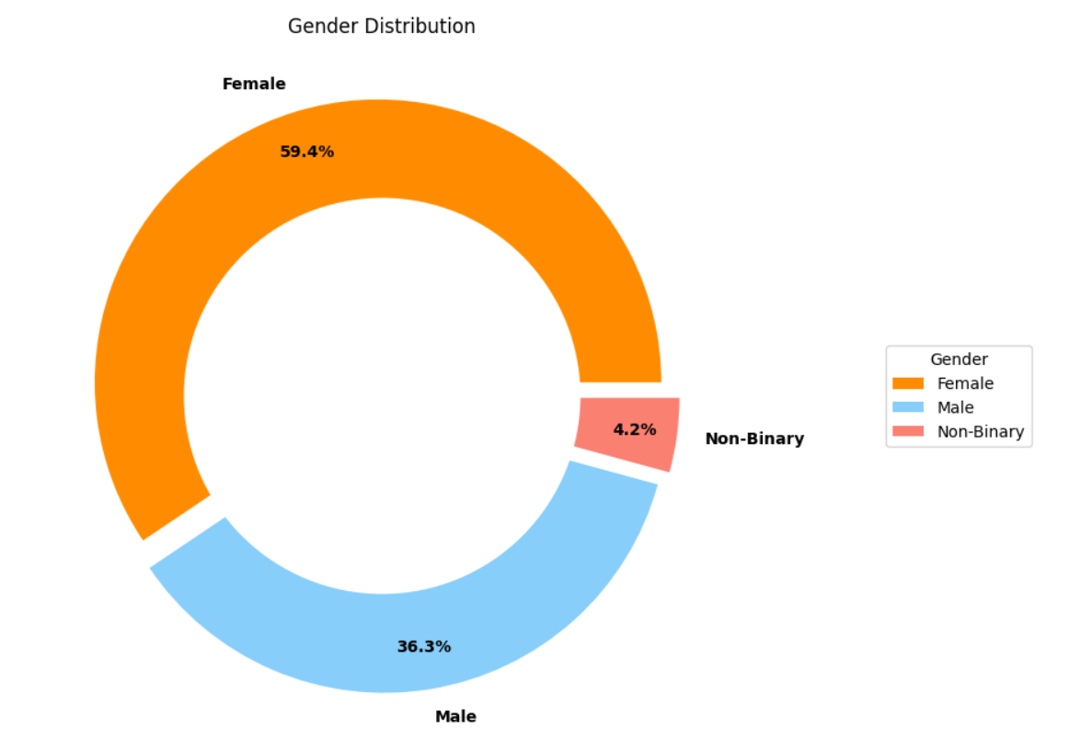
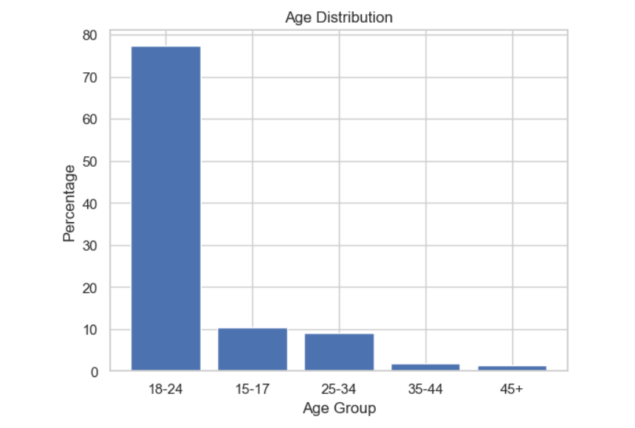
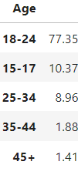
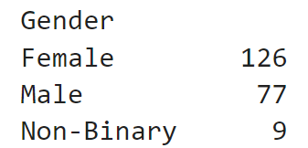
Survey Demographics
About 60% of survey were female students
Participant were predominantly 18-24 of age (78%)
Gender Distribution
Age
Distribution
Notes:
The survey data although not fully but colosely alligns with the CCM's statistics from National Education Center for Statistics which reveals the demographics to be 24 and under (78%). 44 % full time and 47% female.

Slide 16
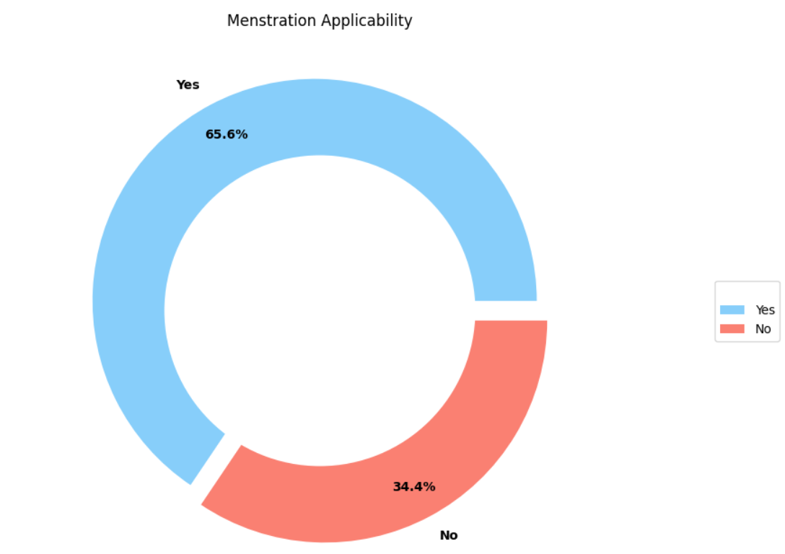
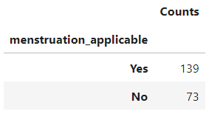
Menstruation Applicability
For 66% of the participants menstruation was applicable
This include students who identify as female, male, or non binary

Slide 17
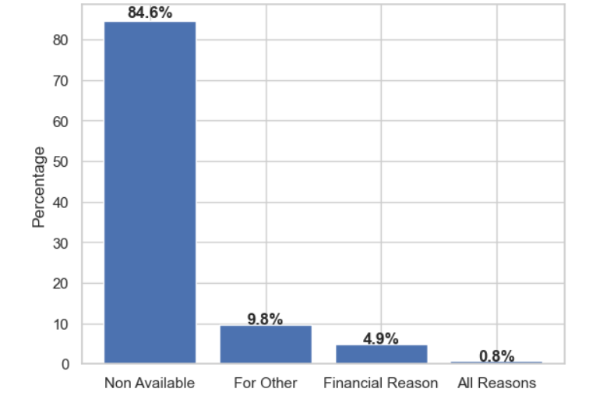
Reasons of Product Usage
Biggest reason:
Not Available Personally or For Other (94%)

Slide 18
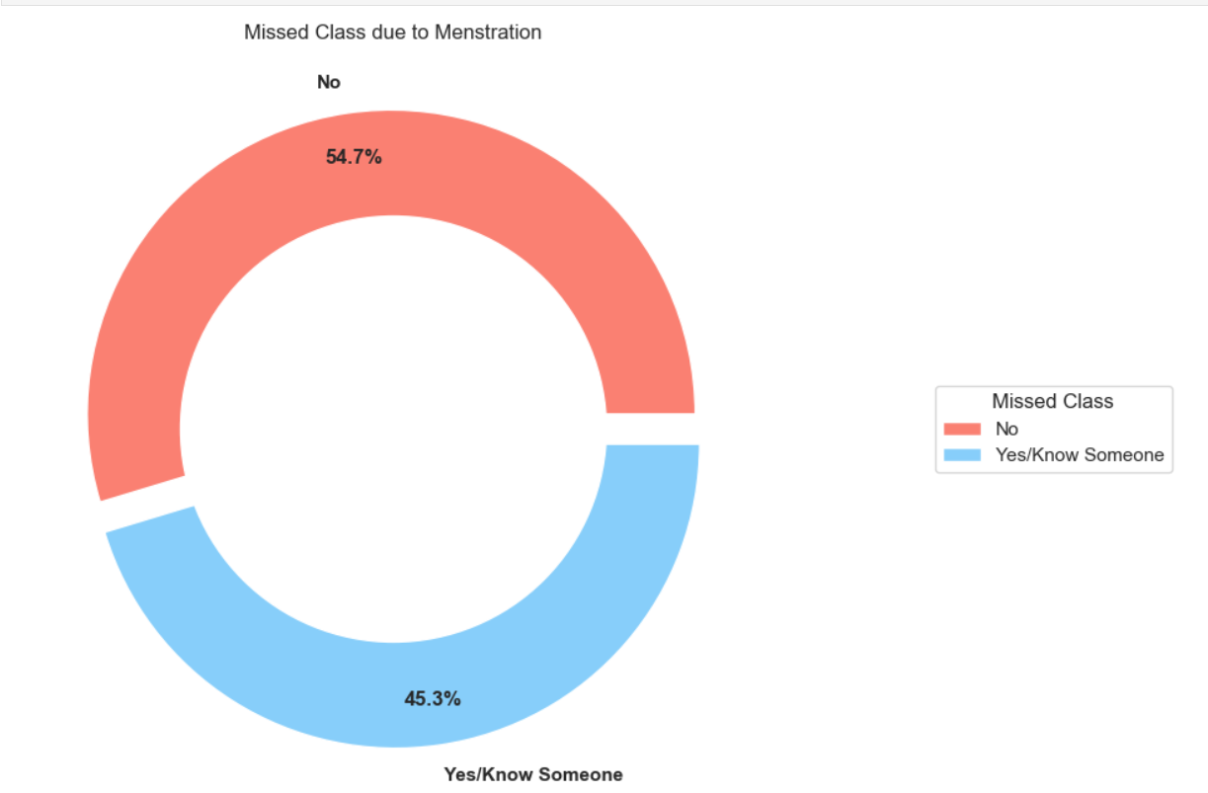
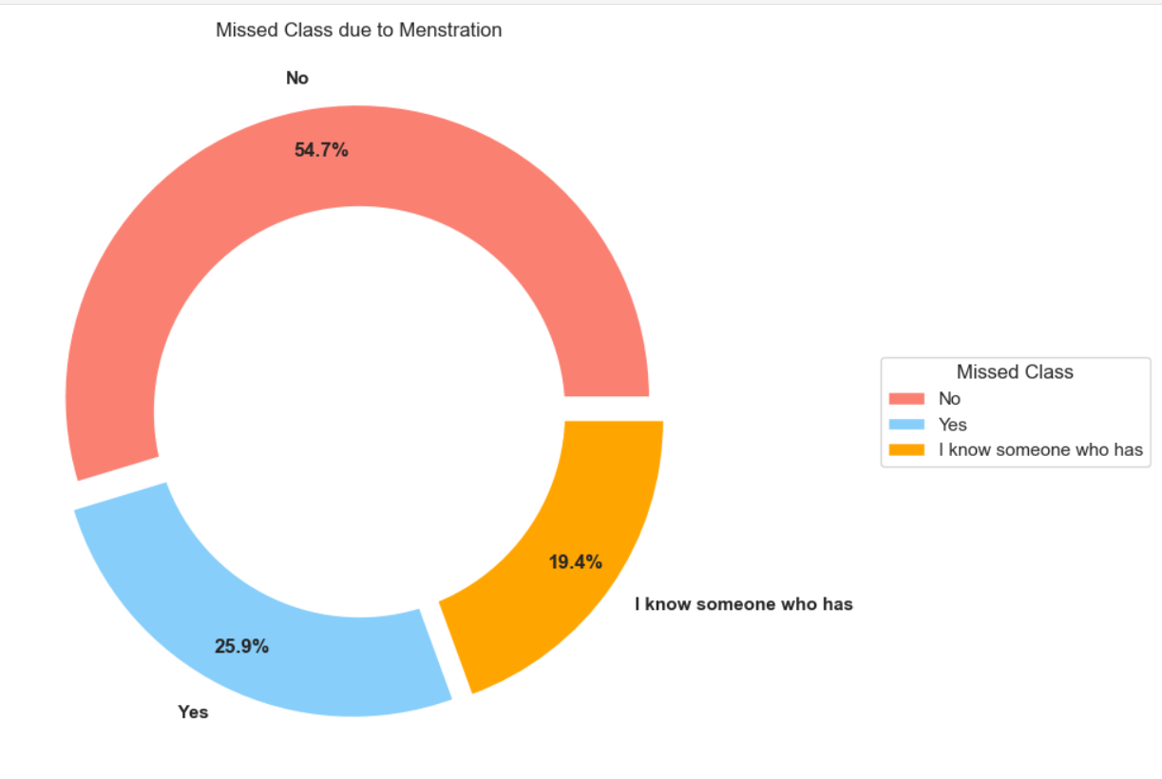
Impact of Menstruation Products
45% of students have missed classed or know someone who has
63 students of the 139
Missed Class due to Menstruation

Slide 19
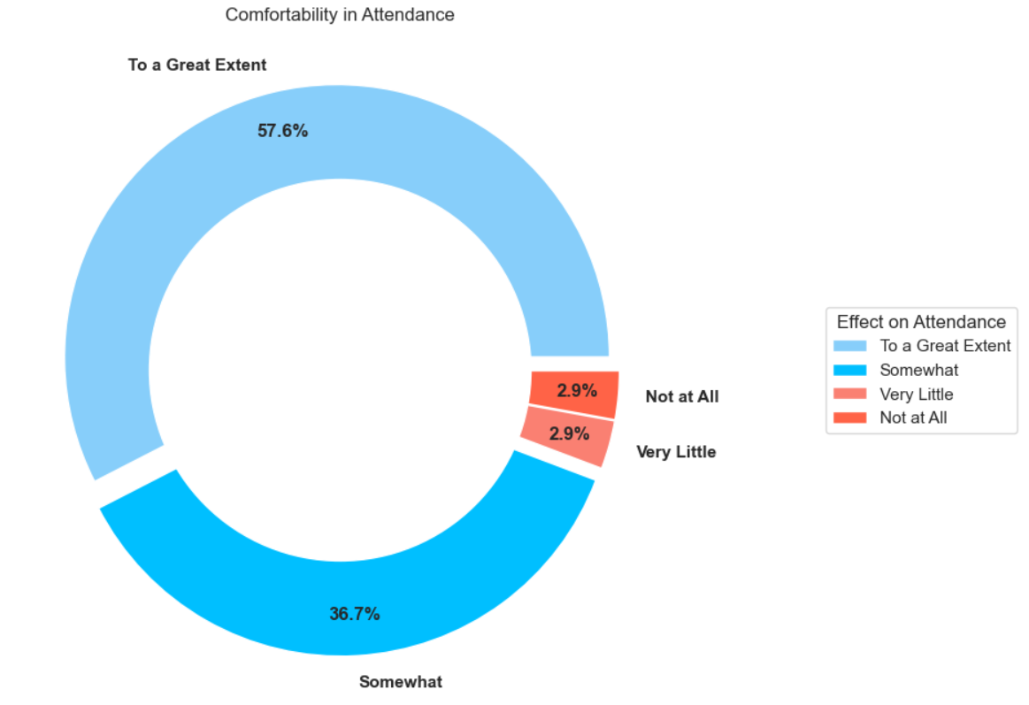
Comfortability in Attendance
Majority of the students see this initiative increasing their comfortability in attending classes To a Great Extent (57.6%)

Slide 20
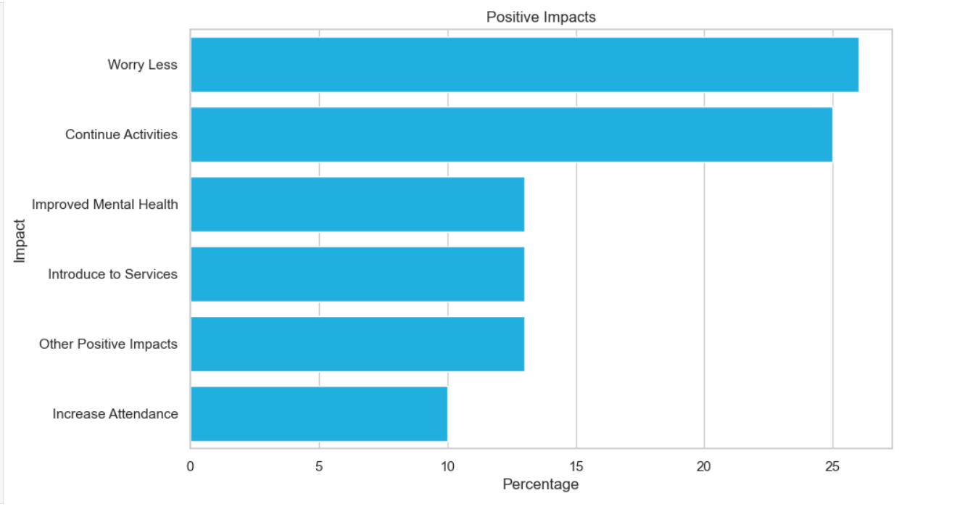
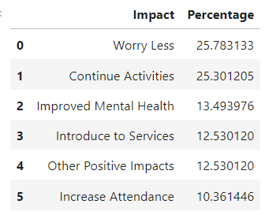
Major Positive Impacts
Half of the students see free products
Helping them continue their daily activities more comfortably
Decrease mental burden of carrying products on hand

Slide 21
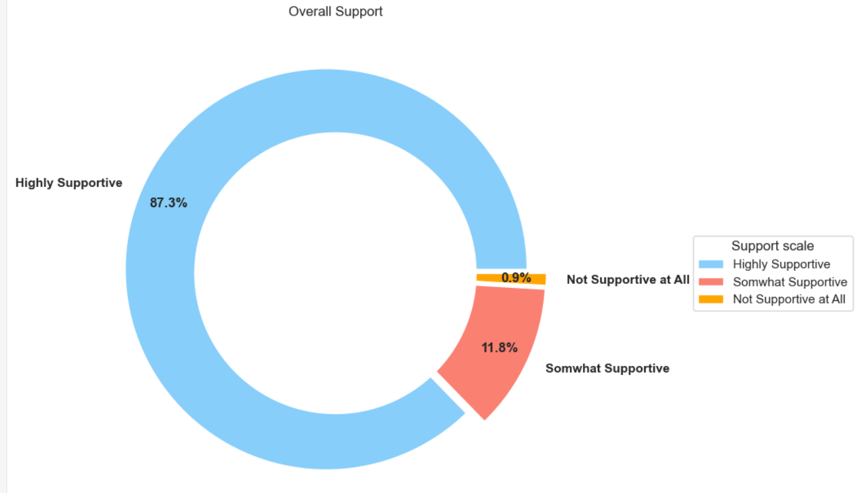
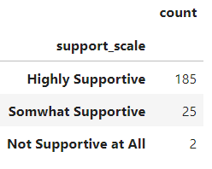
Support of Initiative
Overall Support

Slide 22
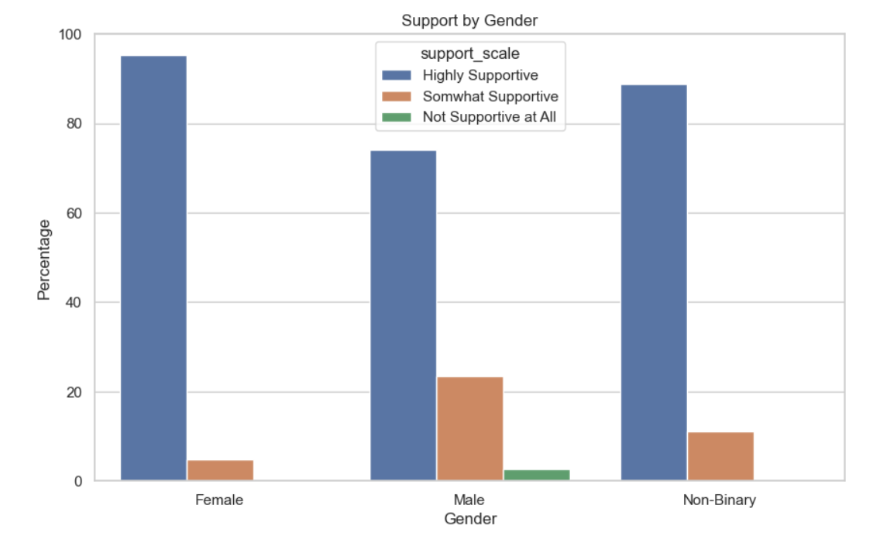
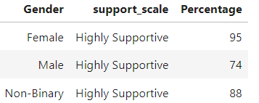
Support of Initiative
Majority of the students within each Gender is either somewhat or highly supportive of this initiative

Slide 23
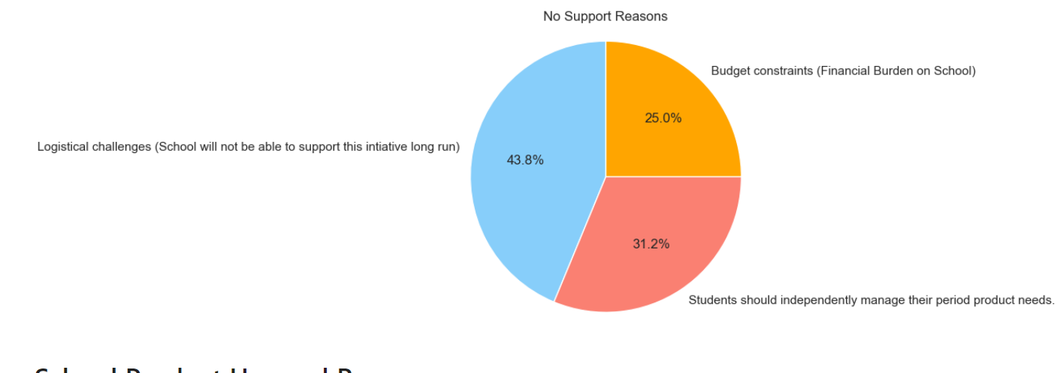
Reasons for No Support
Biggest concern
Logistical Challenge (Longrun Maintenance)

Slide 24
Students Concerns and Future Plans
Expansion
Quality
Improve Dispensing
Expand Options: super, pads, tampons,
(Budget Concern)

Slide 25
Conclusion

Slide 26
Appendix

Slide 27
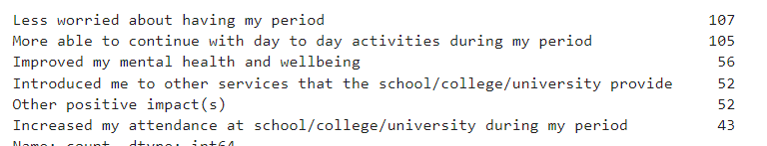
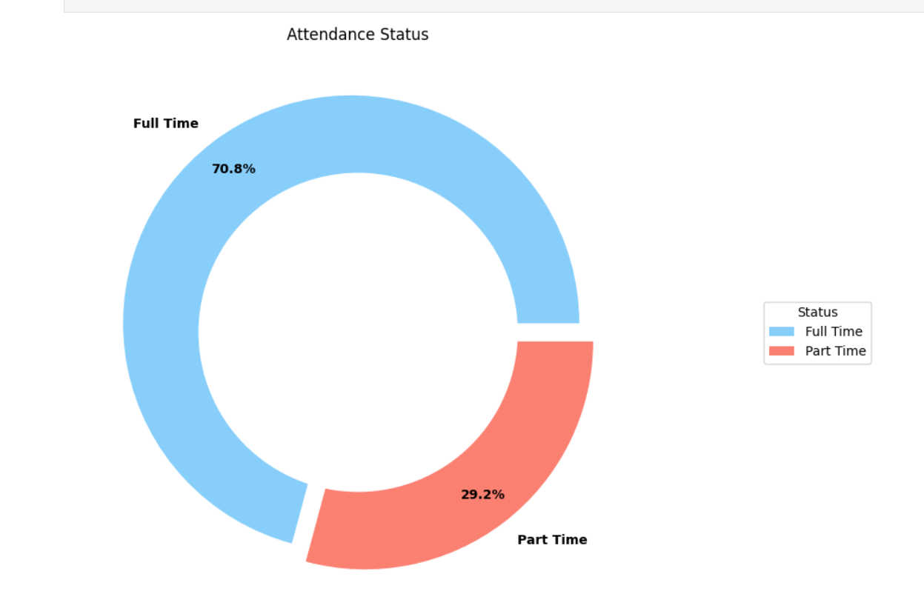
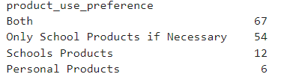
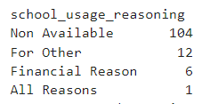
Attendance Status

Slide 28
